Slide 1
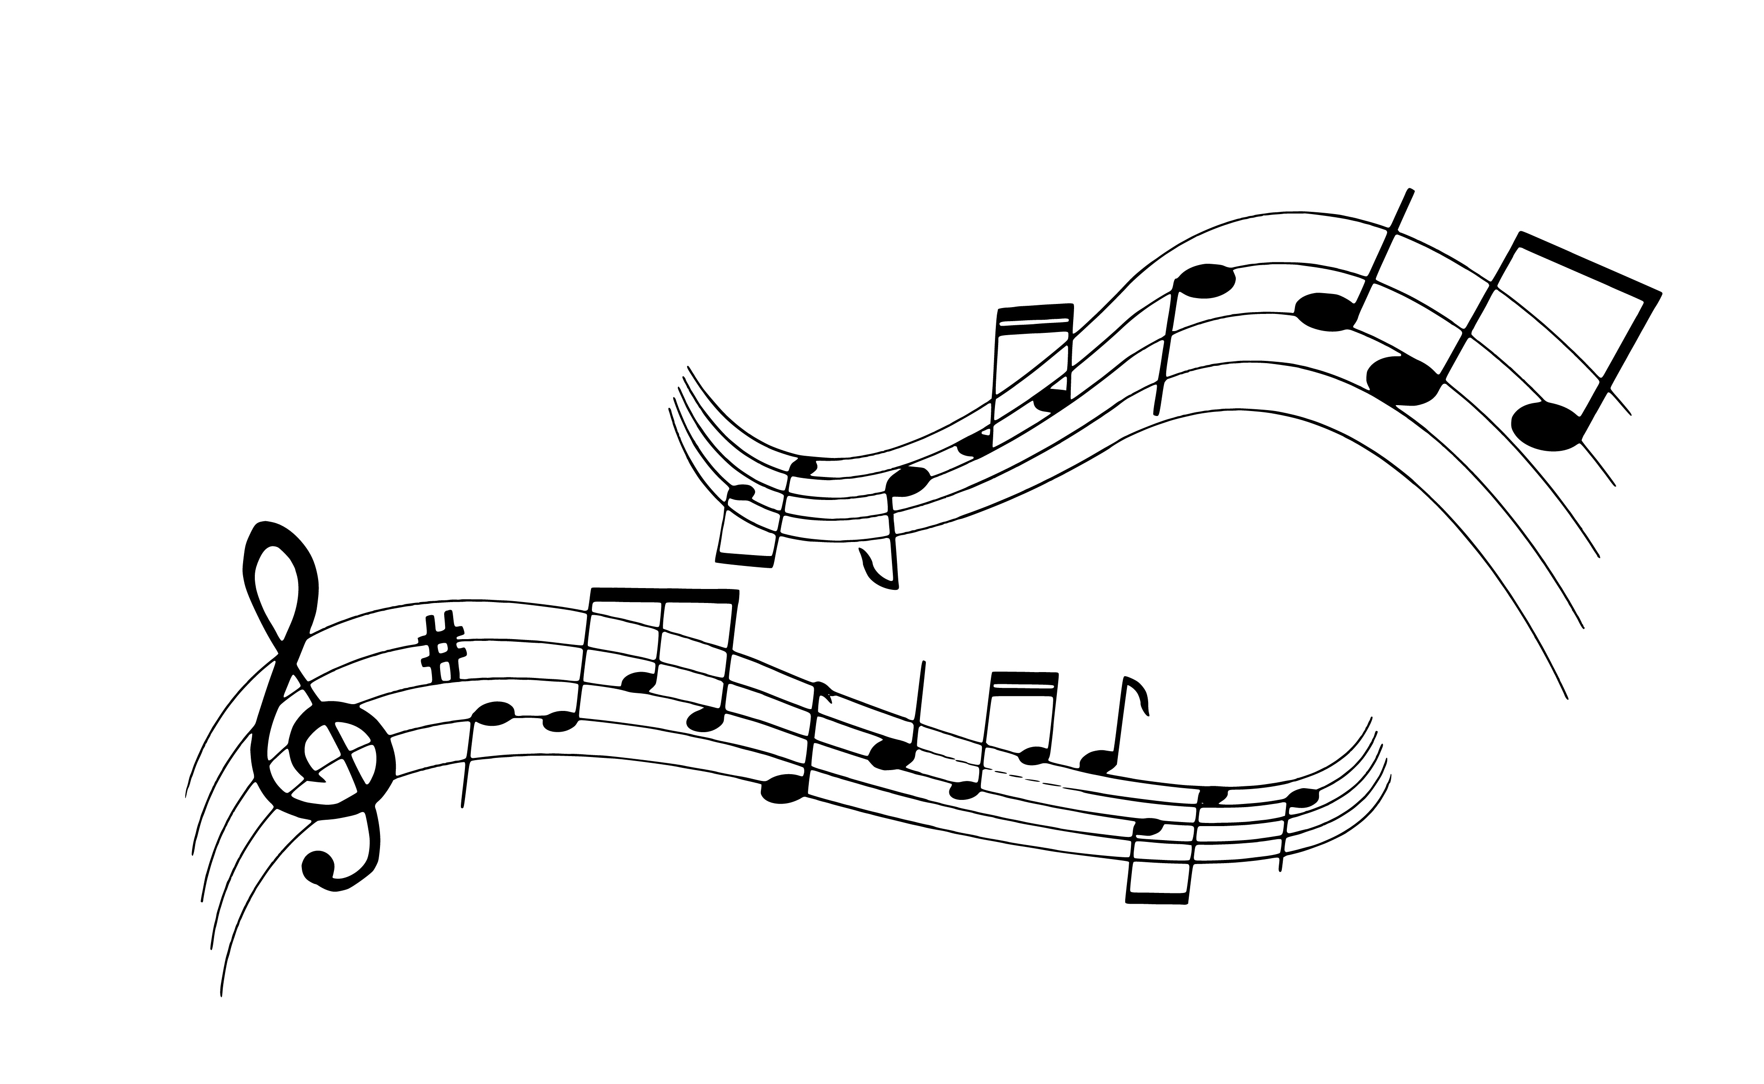
Stylistic Analyses of Hebrew Song Lyrics
Diana Kogan

Slide 2
In 2021, the singer yehoram gaon criticized oriental music, calling it trash, and claiming that its language was flawed, poor and ungrammatical.

Slide 3
Project Objective
- Perform stylistic analyses of Hebrew songs.
- Examine the oriental genre in comparison to other genres to determine whether it holds any unique qualities or differences in quality.

Slide 4
The Data
Dataset of ~15000 Hebrew songs of 167 different artists:
https://www.kaggle.com/datasets/guybarash/hebrew-songs-lyrics
The dataset includes the following information:
- Artist
- Song name
- Song lyrics
- Song word count
- Song unique word count

Slide 5
Data pre-processing - tagging
The dataset was tagged with the following additional information:
- Artist year of birth
- Artist main genre

Slide 6
Data pre-processing - Lemmatization
Lemmatization is a technique used to reduce words to their base or root form, known as a lemma.
Lemmatization takes into account the morphological analysis of the words and uses vocabulary and morphological analysis to obtain the correct base form.

Slide 7
Data pre-processing - Lemmatization
Lemmatization of song lyrics was done using Stanza:
נתן ל הוא מלב אהב
מה ש רצית היה מלך
בניתי ל הוא בית של
הוא כול מה ש נפשך חשק
נתתי לך מלב אוהב מה שרצית היית מלכה בניתי לך בית שלם וכל מה שנפשך חשקה
lemmatized data
original data

Slide 8
methodology
All analyses was performed on the 4 most common genres (with at least 2000 songs) – Pop, Rock, Hebrew music and Oriental.
Non-Hebrew songs (performed by Israeli artists) and songs with less than 10 words were discarded.

Slide 9
methodology
The following was performed to try to answer the project objectives (on both original and lemmatized data):
- Lexical Diversity Analysis
- Topic modeling
- Text embeddings extraction and visualization
- Genre prediction
- Author identification

Slide 10
Lexical diversity analyses
Lexical Diversity Analyses measures the range and variety of words used in a text or corpus, often indicating richness or complexity in vocabulary.
Common metrics include the Type-Token Ratio (TTR) and the Measure of Textual Lexical Diversity (MTLD).

Slide 11
Lexical diversity analyses - TTR
TTR calculates the ratio of unique words (types) to the total number of words (tokens) in a text. A higher TTR indicates greater lexical diversity, reflecting a richer vocabulary.
Hebrew music | Rock | Pop | Oriental
0.6695 | 0.6540 | 0.6376 | 0.6546 | Original
0.5282 | 0.5190 | 0.5002 | 0.5084 | Lemmatized

Slide 12
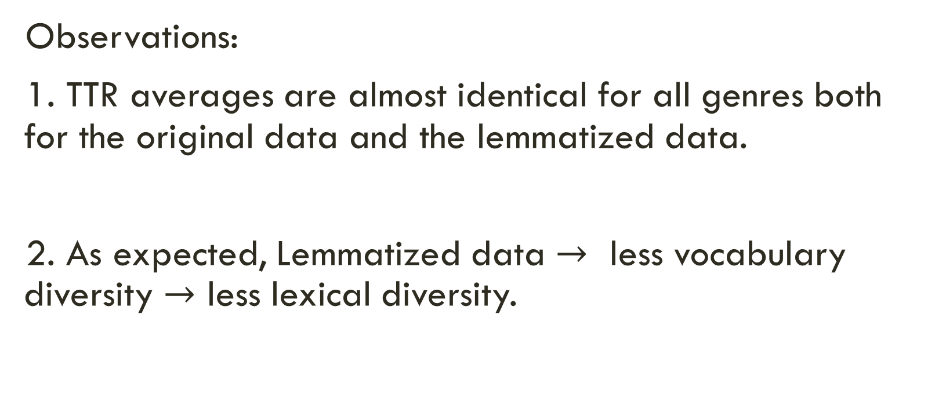
Lexical diversity analyses - TTR
Observations:
1. TTR averages are almost identical for all genres both for the original data and the lemmatized data.
2. As expected, Lemmatized data $→$ less vocabulary diversity $→$ less lexical diversity.

Slide 13
Lexical diversity analyses - MTLD
MTLD calculates the mean length of word strings that maintain a criterion level of lexical variation.
It is designed to be less sensitive to text length, providing a more reliable measure of lexical diversity across varying text sizes.

Slide 14
Lexical diversity analyses - MTLD
A higher MTLD indicates greater lexical diversity, reflecting a richer vocabulary:
Hebrew music | Rock | Pop | Oriental
91.9678 | 81.8480 | 76.6364 | 83.0472 | Original
43.6412 | 41.5895 | 40.1388 | 41.0547 | Lemmatized

Slide 15
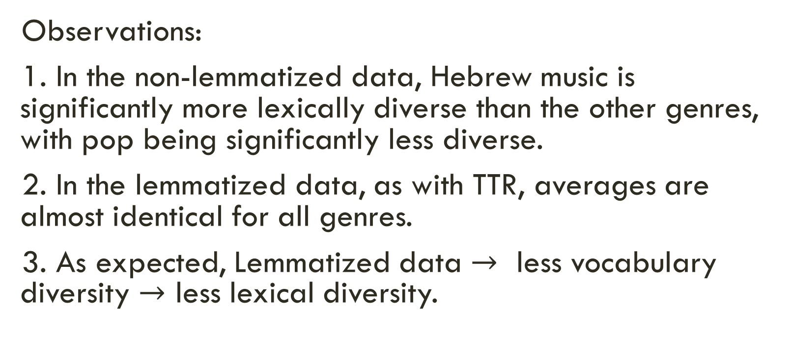
Lexical diversity analyses - MTLD
Observations:
1. In the non-lemmatized data, Hebrew music is significantly more lexically diverse than the other genres, with pop being significantly less diverse.
2. In the lemmatized data, as with TTR, averages are almost identical for all genres.
3. As expected, Lemmatized data $→$ less vocabulary diversity $→$ less lexical diversity.

Slide 16
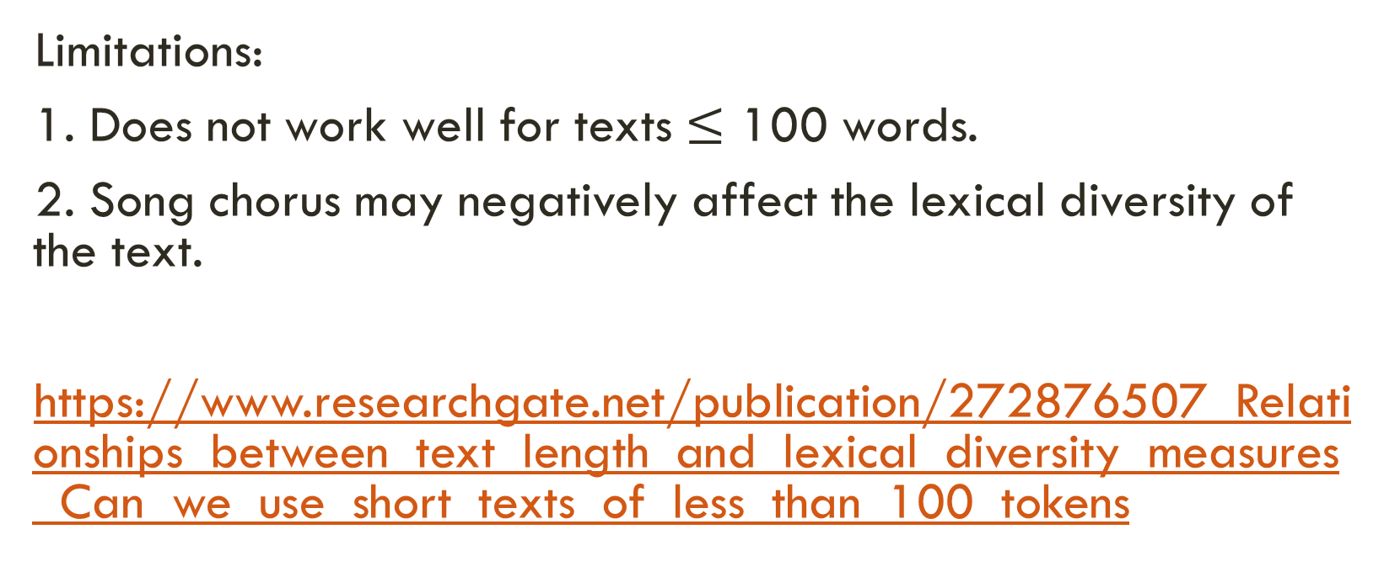
Lexical diversity analyses
Limitations:
1. Does not work well for texts $≤$ 100 words.
2. Song chorus may negatively affect the lexical diversity of the text.
https://www.researchgate.net/publication/272876507_Relationships_between_text_length_and_lexical_diversity_measures_Can_we_use_short_texts_of_less_than_100_tokens

Slide 17
methodology
The following was performed to try to answer the project objectives (on both original and lemmatized data):
- Lexical Diversity Analysis
- Topic modeling
- Text embeddings extraction and visualization
- Genre prediction
- Author identification

Slide 18
TOPIC MODELING
Topic modeling is a statistical technique used to discover the hidden thematic structure within a collection of documents, identifying groups of words that frequently appear together and represent underlying topics. It helps in organizing and summarizing large text corpora by assigning each document a mixture of topics, making it easier to understand the main themes.

Slide 19
TOPIC MODELING
Topic modeling can provide information regarding:
- The vocabulary richness across genres, providing insights into the complexity and uniqueness of the language used in each genre.
- Discover unique or dominant topics in each genre, highlighting common themes or subjects that characterize the genre.

Slide 20
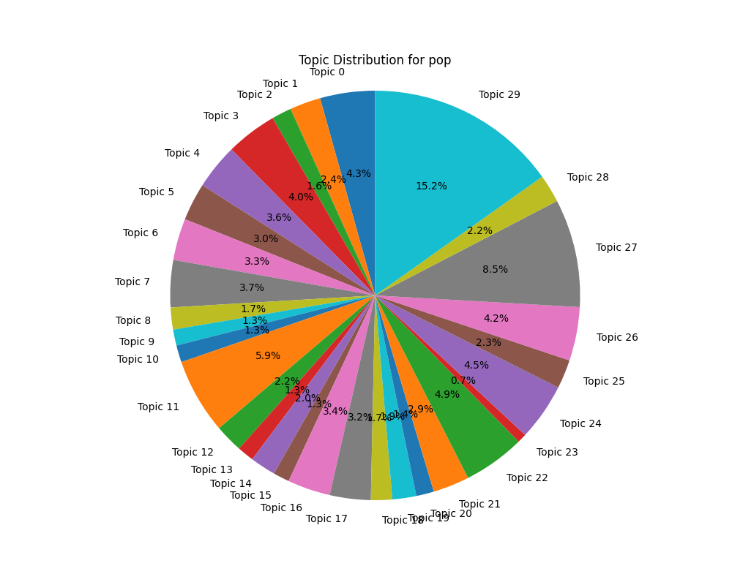
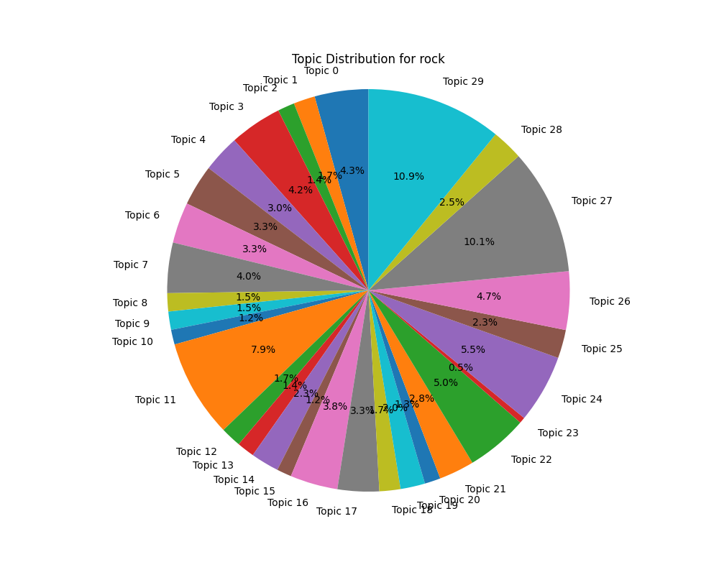
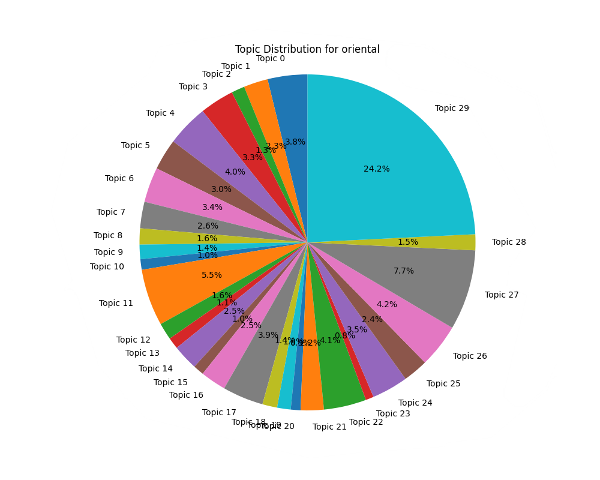
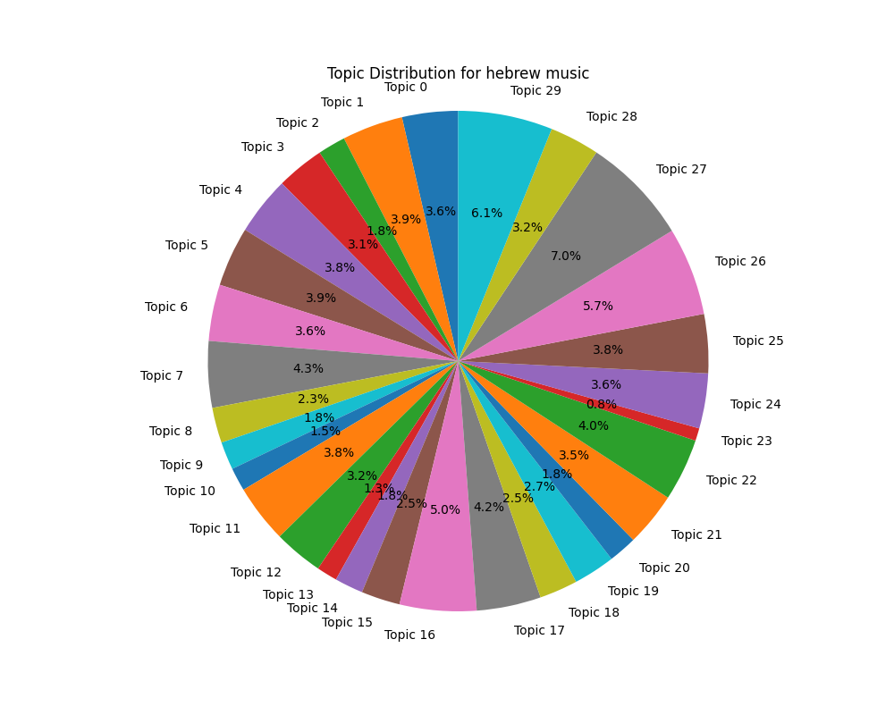
TOPIC MODELING – original Data

Slide 21
TOPIC MODELING – original Data
Topic 29, the love song topic, is the most dominant topic in all genres except Hebrew music. With the highest representation in oriental music:
איך, רוצה, איתך, שלי, הכל, שלך, שוב, הלב, אהבה, אולי, בי, כבר, איתי, יודעת, תמיד, אוהב, שאת, שלא, עכשיו, פעם, בך, להיות, שאני, אין, יודע, בכל, אלייך, לעולם, לאהוב, אלי, האהבה, יכול, הלילה, ממך, בשבילך, שיש, כאן, חיי, פתאום, תגידי, מילים, עלייך, כשאת, עלי, אהיה, אוהבת, החיים, ליבי, יום, תני

Slide 22
TOPIC MODELING – original Data

Slide 23
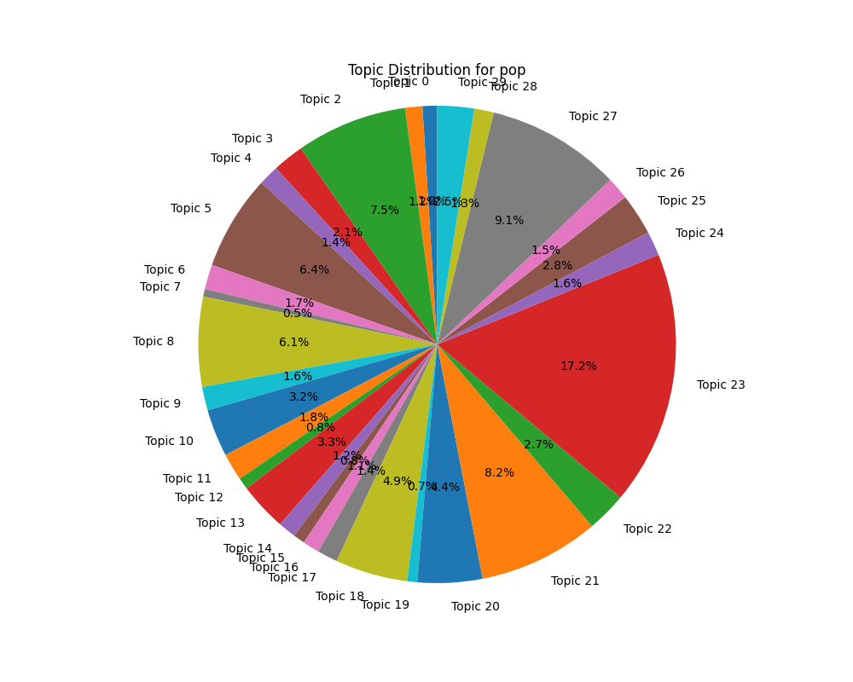
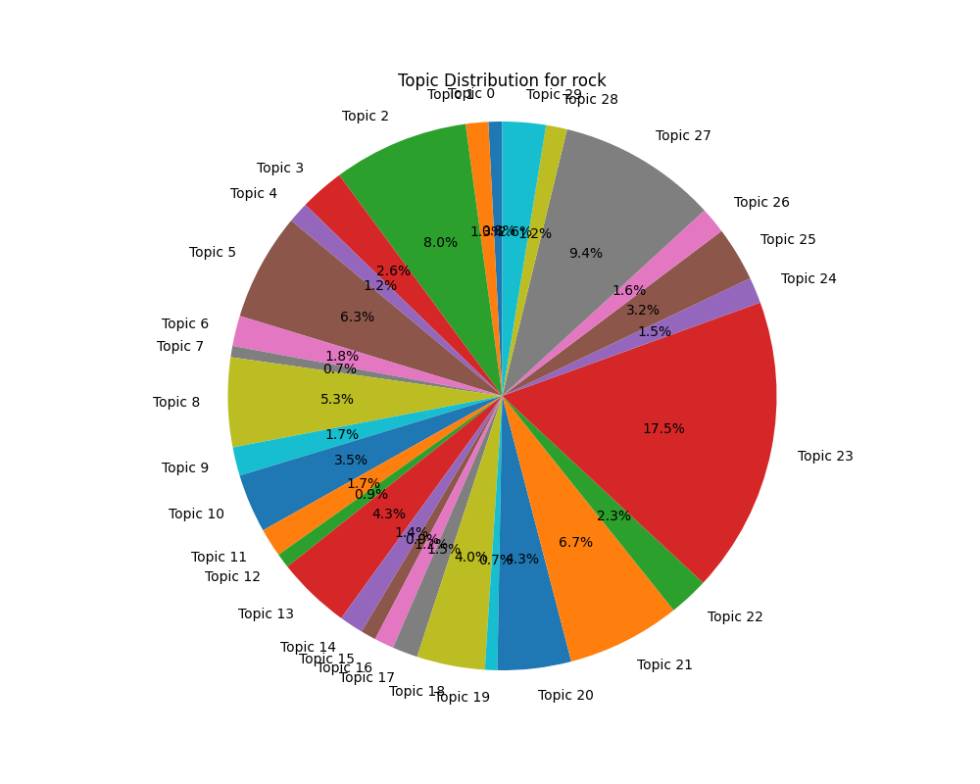
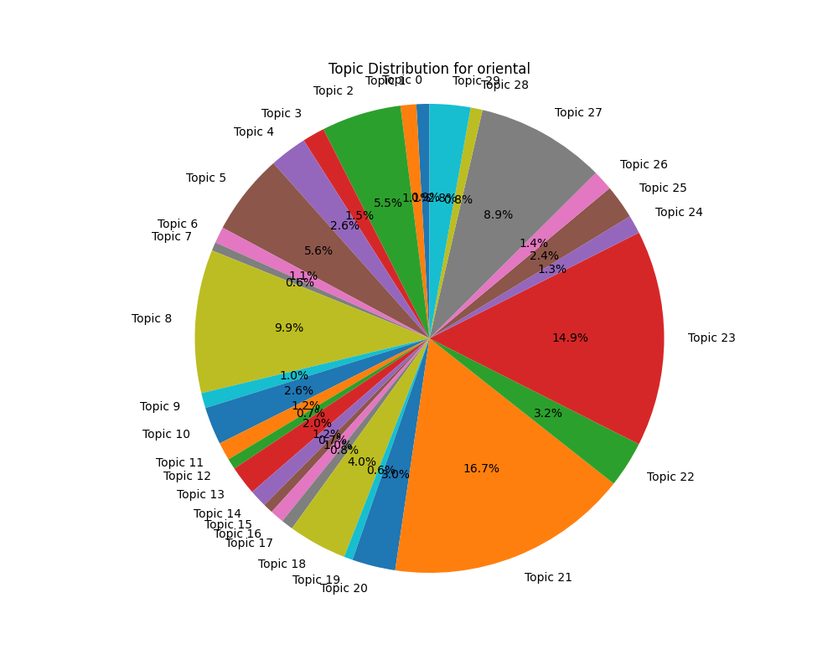
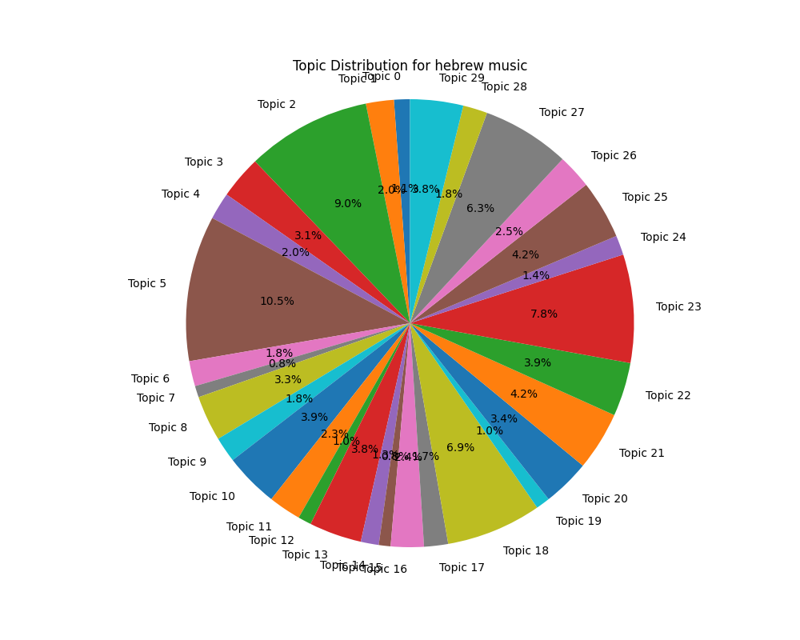
TOPIC MODELING – LEMMATIZED Data

Slide 24
TOPIC MODELING – LEMMATIZED Data
Topic 23, the sad song topic, is the a very dominant topic in all genres except Hebrew music:
ש, כול, היה, אין, בא, זמן, יום, כבר, רצה, כש, סוף, שוב, היום, חזר, הלך, ידע, מקום, נשאר, איך, יכל, לילה, חיים, תמיד, ראה, אמר, חשב, טוב, פעם, פתאום, די, כאן, נגמר, אולי, לקח, ניסה, אחת, עכשיו, נתן, הגיד, דבר, צריך, דיבר, כאב, עולם, לב, מילה, בשביל, כוח, ויתר, שם

Slide 25
TOPIC MODELING – LEMMATIZED Data

Slide 26
TOPIC MODELING – LEMMATIZED Data
Topic 21, the emotional song topic, is the most dominant topic in oriental music (and only in this genre):
ש, כול, אהבה, נתן, איך, היה, אהב, חיים, עולם, לב, רצה, אין, חלום, הלך, ידע, כאב, בא, אחת, תמיד, לבד, טוב, אלוהים, עין, אמר, כש, עכשיו, ראה, ליבי, בשביל, ילד, בלי, דמעה, אהבתי, יד, דבר, שם, יפה, קצת, תקווה, יכל, דקה, מילה, יום, הרגיש, פעם, תראי, גדול, עשה, רגש, עינייך

Slide 27
TOPIC MODELING – LEMMATIZED Data

Slide 28
TOPIC MODELING
Observations:
- In the Hebrew music genre, songs are more spread out across topics.
- While in both pop and rock genres, there a dominant song topic exists, oriental music songs tend to be more centered around 1-3 main topics.

Slide 29
methodology
The following was performed to try to answer the project objectives (on both original and lemmatized data):
- Lexical Diversity Analysis
- Topic modeling
- Text embeddings extraction and visualization
- Genre prediction
- Author identification

Slide 30
Text embeddings – extraction
Text embeddings extraction is the conversion of text into numerical representations that capture semantic and contextual information.
AlephBERT was used for text embeddings extraction.

Slide 31
Text embeddings – extraction
AlephBERT is a Hebrew-specific variant of the BERT model, designed to provide high-quality, context-aware embeddings for Hebrew text. It captures the nuances of Hebrew language, making it particularly effective for NLP tasks involving Hebrew data.
https://arxiv.org/abs/2104.04052

Slide 32
Text embeddings – VISUALIZATION
Text embeddings visualization requires dimensionality reduction.
t-SNE (t-Distributed Stochastic Neighbor Embedding) was used to perform dimensionality reduction.

Slide 33
Text embeddings – VISUALIZATION
t-SNE is a dimensionality reduction technique that visualizes high-dimensional data by converting it into a lower-dimensional space, typically 2 or 3 dimensions, while preserving the local structure and relationships between data points. It is particularly effective for creating meaningful and interpretable visualizations of complex data.

Slide 34
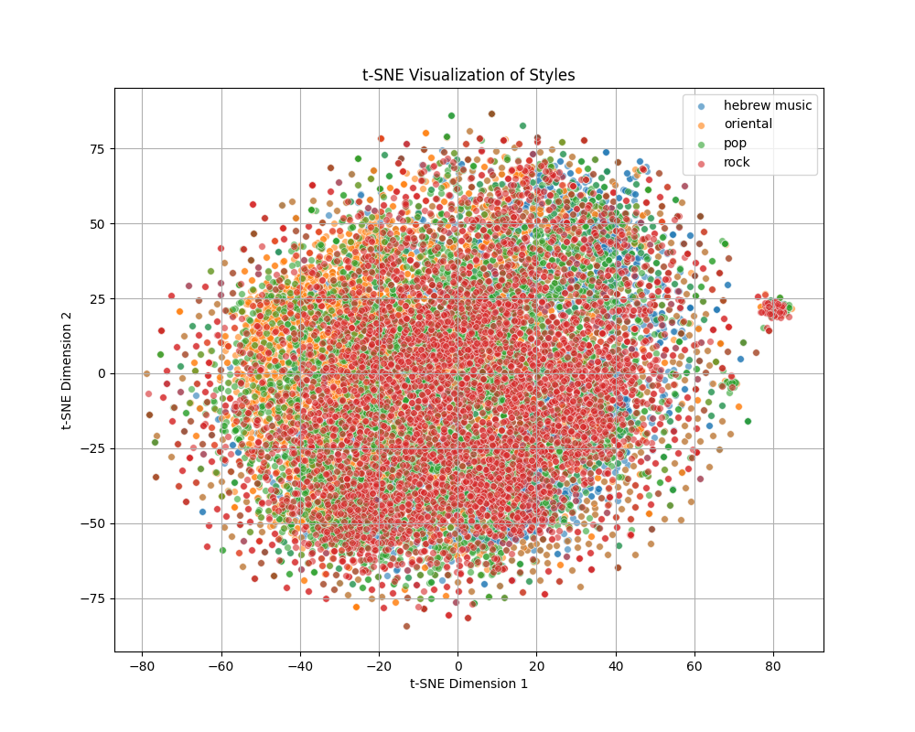
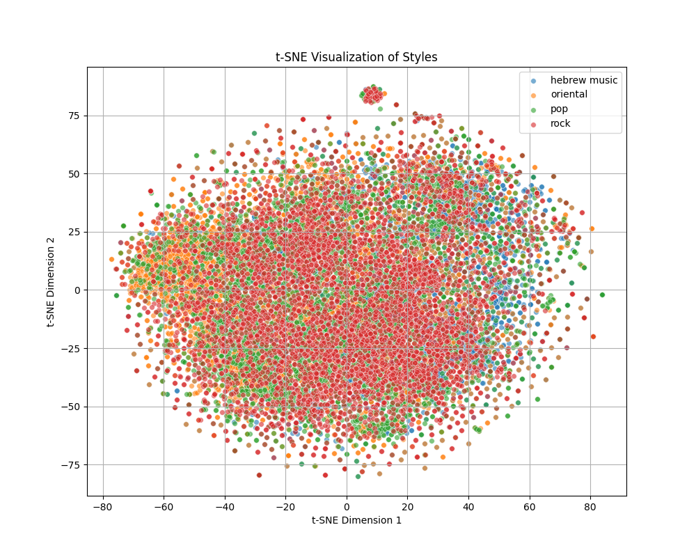
Text embeddings – VISUALIZATION
lemmatized data
original data

Slide 35
Text embeddings – VISUALIZATION
No obvious genre clusters
lemmatized data
original data

Slide 36
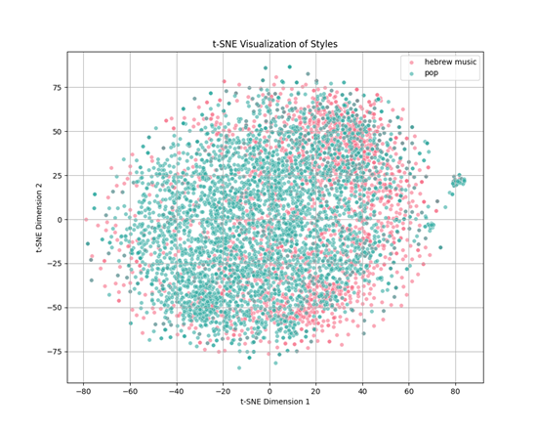
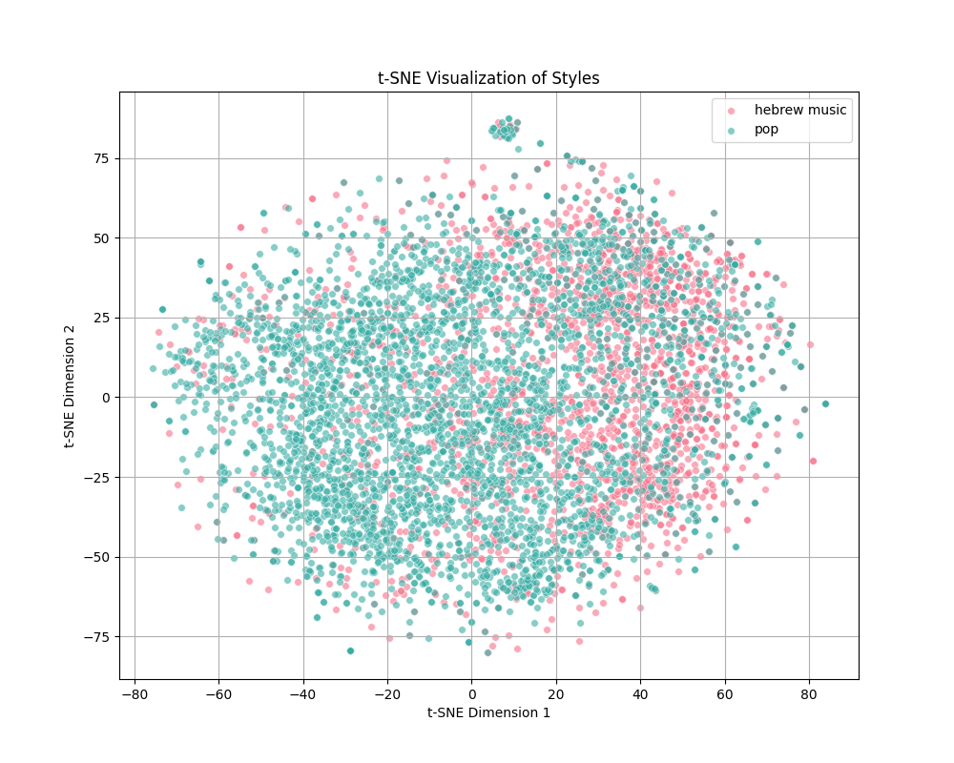
HEBREw music vs pop
lemmatized data
original data

Slide 37
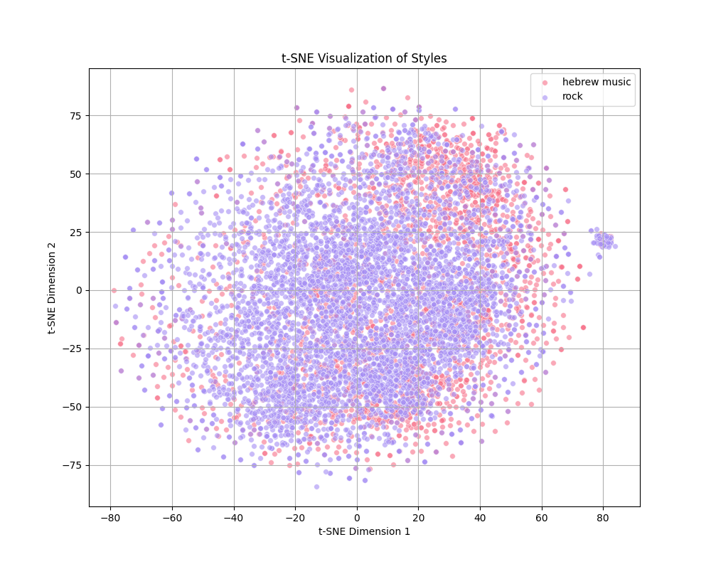
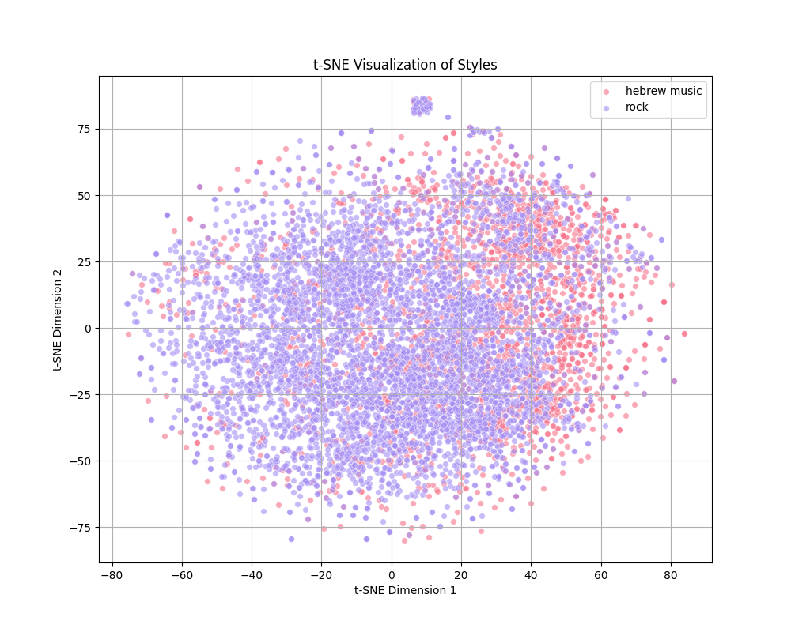
Hebrew music vs rock
lemmatized data
original data

Slide 38
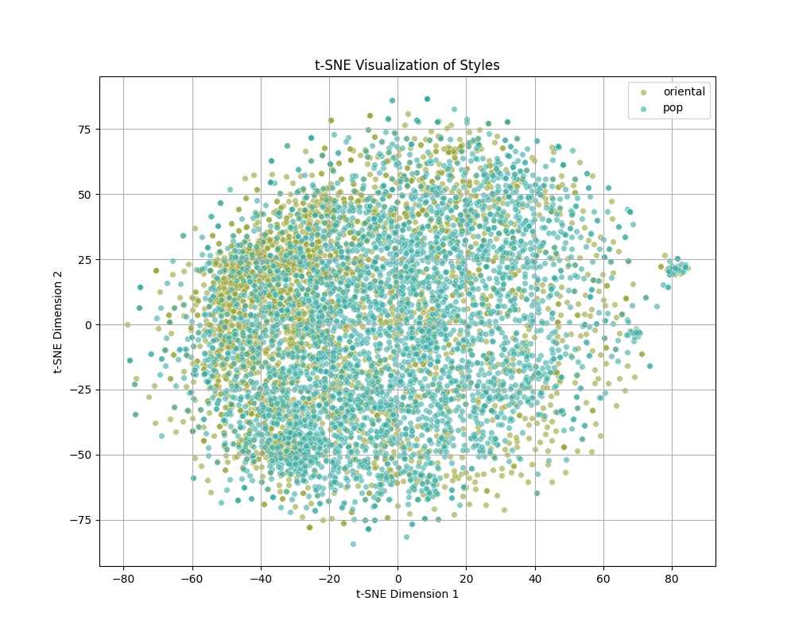
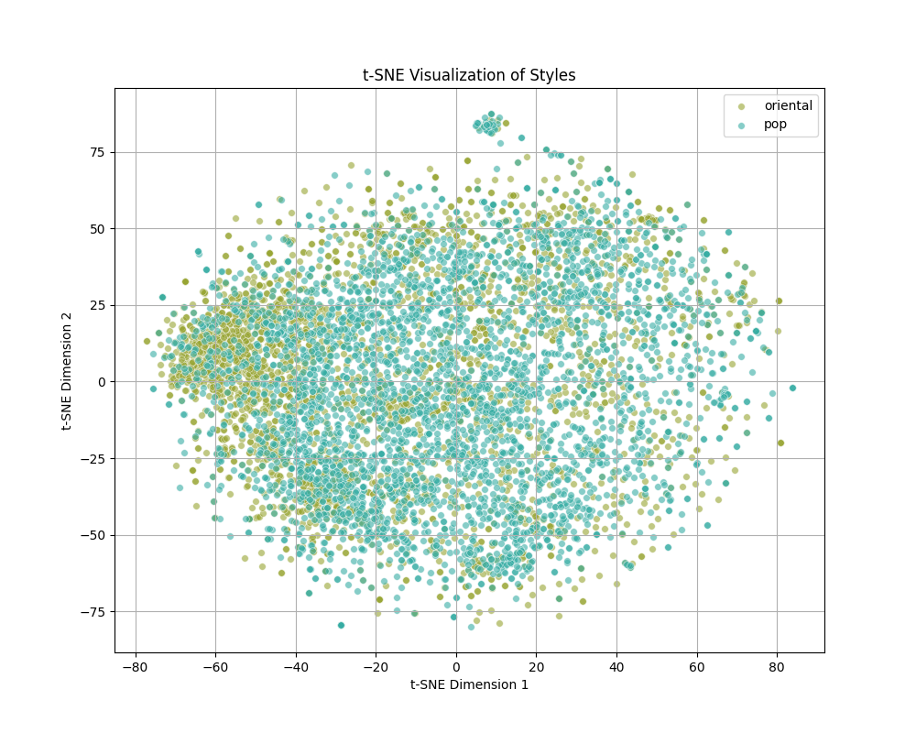
Oriental vs pop
lemmatized data
original data

Slide 39
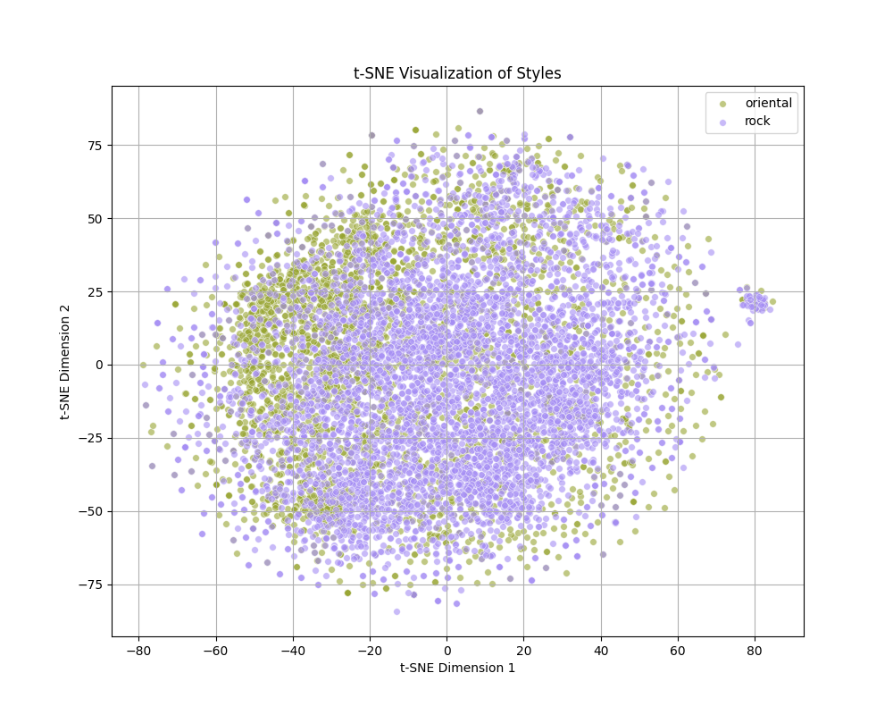
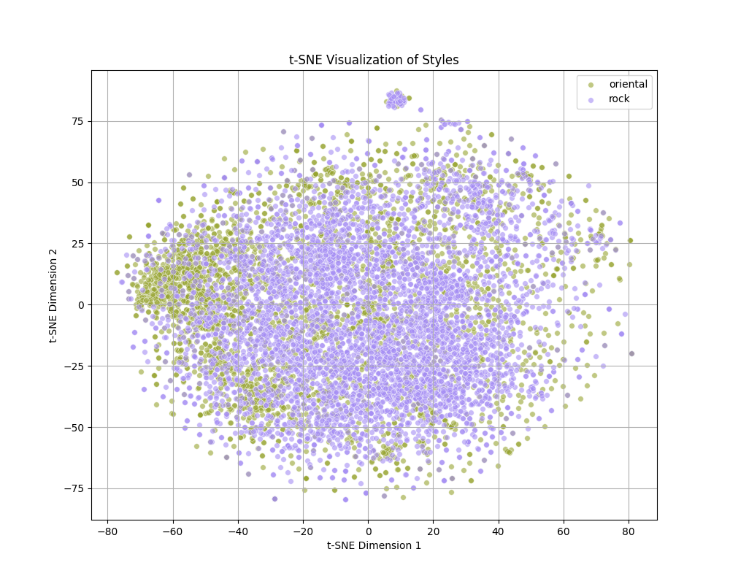
Oriental vs rock
lemmatized data
original data

Slide 40
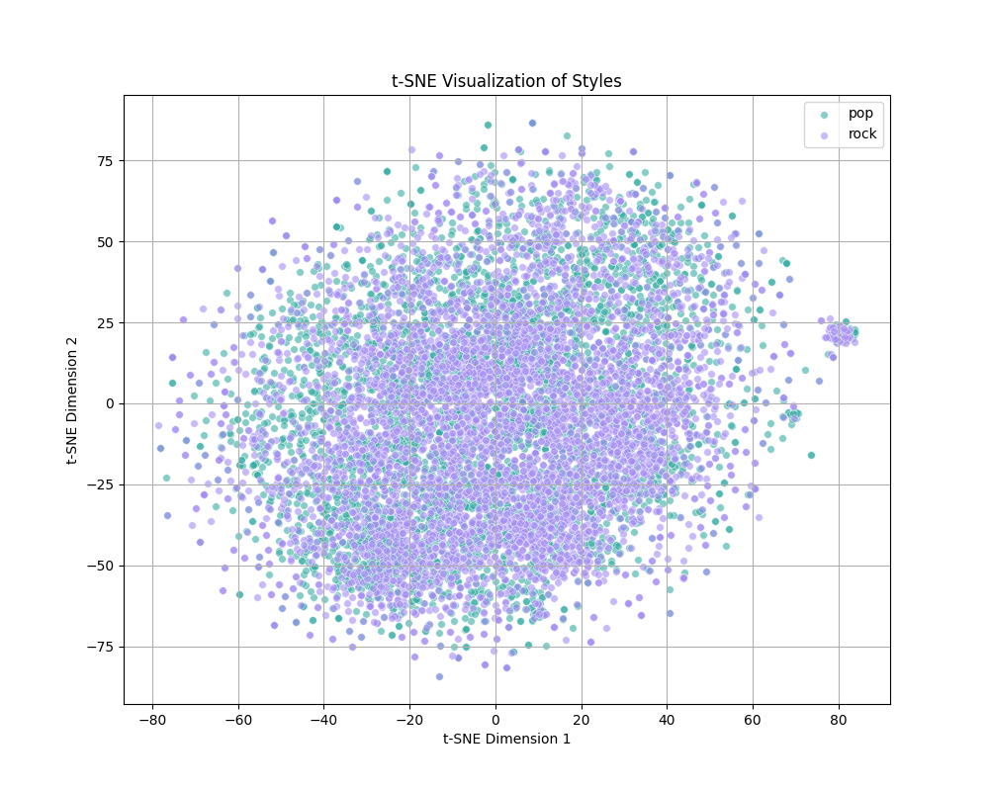
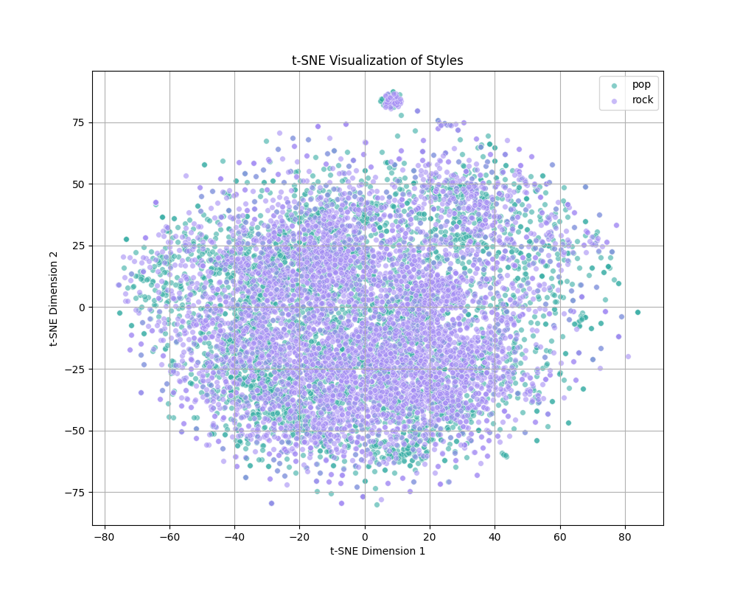
POP vs rock
lemmatized data
original data

Slide 41
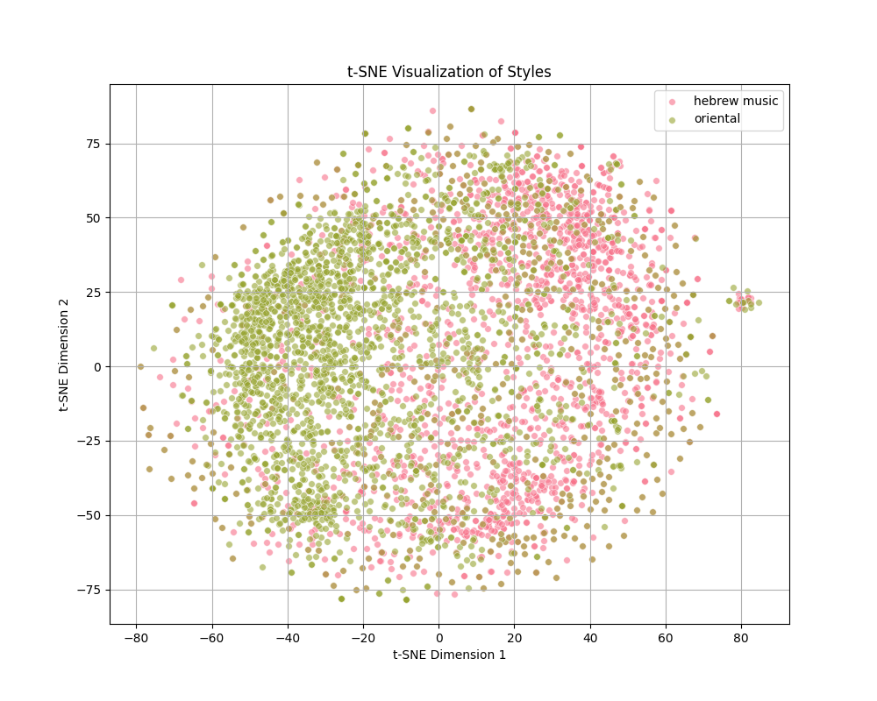
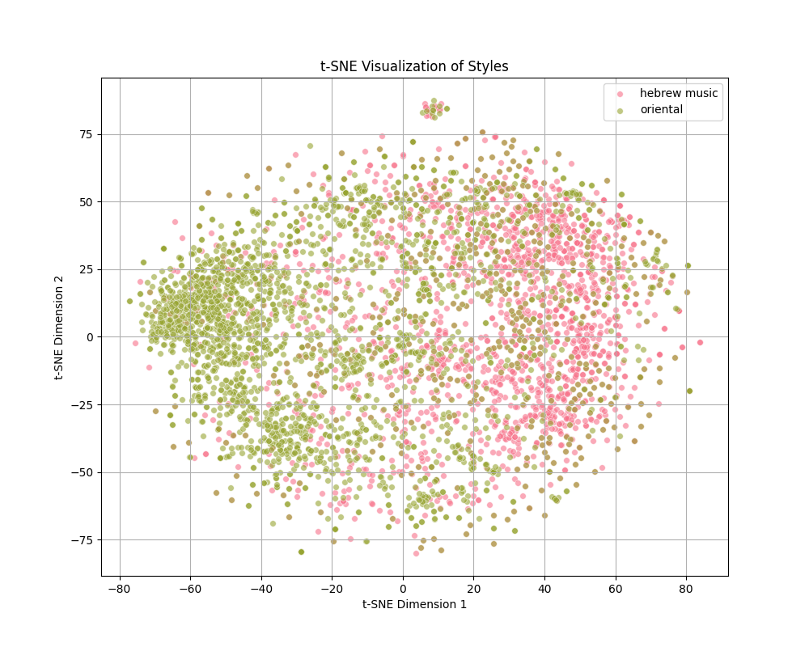
Hebrew music vs oriental
lemmatized data
original data

Slide 42
Text embeddings – VISUALIZATION
Observations:
1. No obvious clusters except for Hebrew music and Oriental genres.
2. Lemmatized data points vary less than the original data points. This is expected considering lemmatization reduces the vocabulary size, thus the data variation.

Slide 43
methodology
The following was performed to try to answer the project objectives (on both original and lemmatized data):
- Lexical Diversity Analysis
- Topic modeling
- Text embeddings extraction and visualization
- Genre prediction
- Author identification

Slide 44
Genre prediction
Music styles that are easier to predict may be easier to distinguish from other styles thus may be more unique.
A logistic regression model was trained using the text embedding with the aim of predicting the text embedding genre:

Slide 45
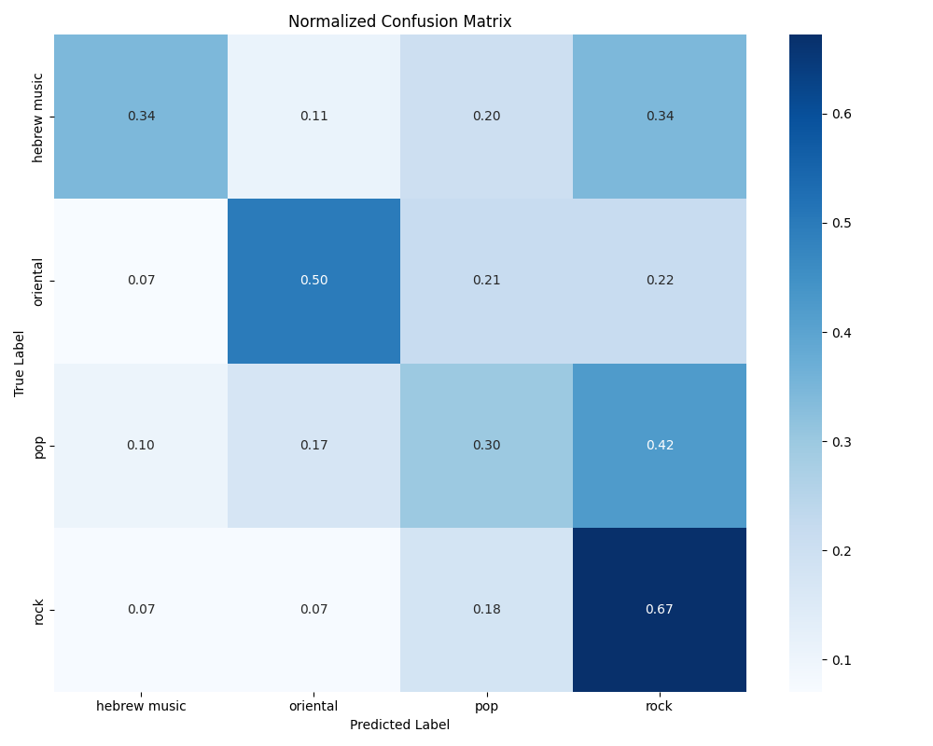
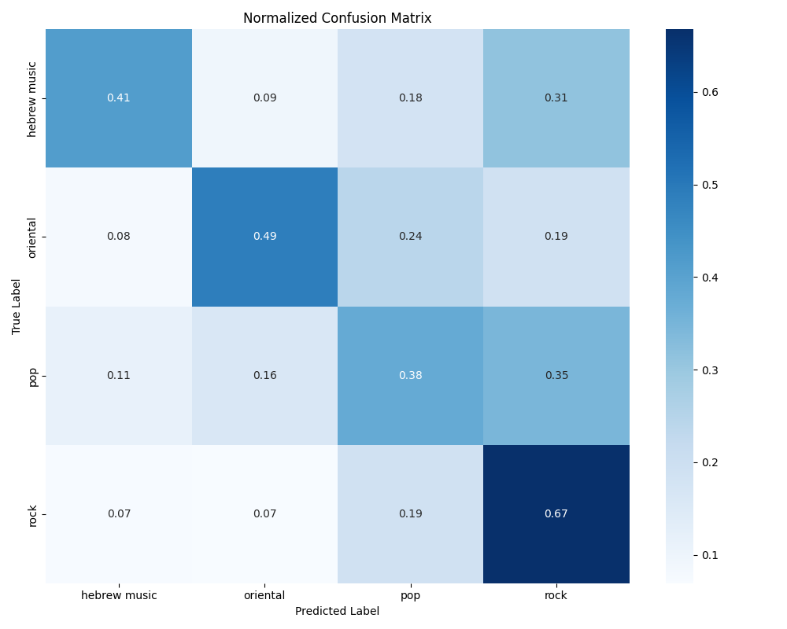
Genre prediction
lemmatized data
original data

Slide 46
Genre prediction
Observations:
1. Rock is the most correctly predicted genre (most likely to be incorrectly labeled as pop).
2. Pop is the least correctly predicted genre (most likely to be incorrectly labeled as rock).
3. Oriental music is the 2nd most correctly predicted genre (most likely to be incorrectly labeled as pop/rock)

Slide 47
Genre prediction
Observations:
4. Lemmatization mostly affects the genre prediction of pop and Hebrew music – causing their prediction to be ~20% less accurate.

Slide 48
methodology
The following was performed to try to answer the project objectives (on both original and lemmatized data):
- Lexical Diversity Analysis
- Topic modeling
- Text embeddings extraction and visualization
- Genre prediction
- Author identification

Slide 49
AUTHOR IDENTIFICATION
Author identification is the task of determining the author of a given text by analyzing stylistic and linguistic features unique to each author's writing.
High author identification rate can be a result of:
1. A distinct style from the rest of the genre authors.
2. All authors song being very similar, thus easy to identify.

Slide 50
AUTHOR IDENTIFICATION
- 6 most prominent artist were chosen from each genre.
- 111 random songs were chosen for each artist.

Slide 51
AUTHOR IDENTIFICATION
original data
Hebrew music | Rock | Pop | Oriental
0.3228 (+/- 0.0335) | 0.3393 (+/- 0.1067) | 0.4535 (+/- 0.0598) | 0.3453 (+/- 0.0897) | Mean Accuracy
0.3229 (+/- 0.0316) | 0.3394 (+/- 0.1023) | 0.4503 (+/- 0.0596) | 0.3403 (+/- 0.0840) | Mean F1-score
lemmatized data
Hebrew music | Rock | Pop | Oriental
0.3378 (+/- 0.0579) | 0.3453 (+/- 0.0636 | 0.3993 (+/- 0.0597) | 0.3499 (+/- 0.0687) | Mean Accuracy
0.3364 (+/- 0.0627) | 0.3433 (+/- 0.0639) | 0.4016 (+/- 0.0579) | 0.3490 (+/- 0.0615) | Mean F1-score

Slide 52
AUTHOR IDENTIFICATION
Observations:
1. Best results on pop genre.
2. The rest of the genres (including oriental) have similar results to one another.
3. Biggest affect of lemmatization is on pop genre (reducing relative identification rate by ~15%).

Slide 53
summary
- TTR showed very similar results for all genres on both lemmatized and non lemmatized data (with a slight lexical diversity advantage to Hebrew music genre).
- MTLD showed very showed very similar results for all genres on lemmatized data. For non lemmatized data, Hebrew music was found as the most lexically diverse, while pop was found as the least one.
- Topic modeling showed that oriental music is the genre that is most focused on specific topics, while Hebrew music was the most spread-out genre across topics.
- Text embeddings visualization showed most distinct clustering of Hebrew music and oriental genres.
- Genre prediction showed rock as the most accurately predicted genre, followed by oriental music genre. Pop being the least accurately predicted.
- Author identification showed highest accuracy on pop genre.

Slide 54
Conclusions
- In total, the experiments made do not show a genre that is significantly stylistically different or better from other genres over all methods used.
- Lexical diversity analyses and topic modeling showed best results (indicating lexical richness) on Hebrew music genre.
- MTLD, Genre Prediction and Author Identification results indicate it as being the least lexically rich genre.

Slide 55
LIMITATIONS
- Song genres were tagged per artist and not per song, thus making the results least accurate.
- Some songs are influenced by several genres making analyses task difficult.
- Lexical richness can be affected by the era the song was created in and not by the genre it belongs to.

Slide 56
Future directions
- Analyzing the affect of the era the song created in on lexical richness.
- Analyzing songs as part of a full body of work (album) and whether lexical richness is affected by it vs. lexical richness of singles.

Slide 57

THANKS FOR LISTENING…

